Slide 1
UALinkAlchemy overview
Basic flows
Updated Sept 2025

Slide 2
Motivation of this effort
The 1849 California gold rush showed suppliers of tools/equipment was lower risk to adding value and impact compared to gold-diggers.
Similarly with AI landscape, there are many efforts (quantum, in-memory-calc, etc) that will likely suffer or iterate from Amdahls law when fully implemented.
UALinkAlchemy aims to provide memory access tools for any of these efforts.

Slide 3
MVP thoughts (or where this effort can provide value today and a few years hence)
Basic memory pooling at rack/pod scale. ~50% of platform cost in memory, how can this be shared/scaled appropriately.
Shared memory without snoop overheads (localized coherency control)
Academic HW framework of memory studies, enabling graduate-level advancements (i.e. prioritized queue latency studies)
Interfacing to novel in-memory startups (photonics/capacitive/etc)
While starting on Ethernet/UALink, can be easily adapted to CXL, NVLink, UCIe as industry evolves.
Validation block of UALink member companies.
IP interface block for “memory as a service” ASIC (i.e. Network Attached Memory NAM)
CPU/GPU/xPU IP block to attach to an SoC.

Slide 4
Memory response variation and cache coherency scope
CPU or GPU
Core mesh
Smallest granularity is 64B cacheline
MC DDR
CLx
As DRAM txns increase, loaded latency due to queueing with up to 500ns across all memory accesses. This is bad for real-time OS workloads and cross-VM conflicts.
MC DDR
~40-500ns
CLy
Other Skt IF
Low lat
MC UALink
~500ns
Prioritized queues helps guarantee latency SLA and put lower priority access (i.e. speculative prefetch, at lower priority)
CLz
High lat

Slide 5
MMU translation (and benefit of UALink)
Core in VM context
Core in VM context
Core in VM context
DDR MC converts to row/col addr
UALink
MMU
MMU
MMU
Physical, or Real, memory address
PCIe/CXL root port converts to IO memory space for DMA operations. TLB is managed to map to OS tables (x86=IOMMU, ARM=SMMU)

Slide 6
C++
With OOP, stdlib.h will dynamically size arrays (i.e. new <obj>)
So if initial array size is <10> and one more object is created, then the library will autoallocate more space, i.e. <15> to grow the memory footprint.
This is to effectively perform as array grows. I.e. 12 count will be order (1) complexity. (Stdlib.h has certain preallocation algo, ignore for now.)
Upon new <obj>, stdlib malloc’s memory space of size obj. This results in a physical memory base address obj for future references. (i.e. with obj.name = “Steen”, compiler knows memory address of obj.name)
Idea is to leverage stdlib.h to do ualink.h

Slide 7
Code mapping
C++ app example
#include stdlib.h
new citizen record;
Record.name = “Steen”;
Record.photo = pix.jpg;
…
Delete record;
Compiler/lib translation
Record.baseaddr = malloc(64KB, RW, noswap); //results in base address for record.
Movstr record.addr <= “Steen”
//set pointer to pix.jpg
…
Free record.base
Compiler/lib translation
Scapy malloc 64KB and return record.base.addr pointer
Scapy write record.base <= “Steen”
…
Scapy free memory/deallocate
{Note that scapy is just a prototype mechanism emulating UALink protocol. Long term, there will be CPU/GPU/XPUs with direct UALink interfaces like DDRx.
I.e. Malloc returns 0x2000, and OS pagetable mapped to 0xFE500 }
C++ UALink library example
#include ualink_lib.h
New_ualink citizen record
UALinkrecord.name = “Steen”;
UALinkrecord.photo = pix.jpg;
…
Delete record
This enables discussion on how existing source code can be adapted to utilize UALink-attached memory by adapting C++ stdlib.h references with ualink_lib.h references.
(I.e. DDR-only app performance compared to UALink prototype performance.)

Slide 8
#include ualink_lib.h
AI_code_alg() Define_base dataset //now we want to convolve, m-mult, etc against 100TB of memory ualink_malloc(100TB) // now 100TB is addressable by user code For (i): AI_op (*base *^ ualink_mem(offset[i]) prefetch(ualink_mem[i+1]) end-for-i

Slide 9
UALink FPGA overview
FPGA with soldered down SDRAM and DRAM
Future expansion
xPU UALink stimulus system
NIC
DRAM/SDRAM/Optane/SSD
10GbE
xPU UALink stimulus system
NIC
10GbE
nf0 = close to PCIe IF
SCAPY tool
Acts like a DDR DIMM

Slide 10
Physical prototype
Virtex5 TX240T
2x 10GbE Intel x550 NIC
Stimulus system Ubuntu 18

Slide 11
FPGA chipscope seeing an “AAAA” pkt (Sept’25) TX/RX port loopback shows .323265-.297131 = 26.1us RTT loopback hardcoded to 0, verified with port 1.
Notes:
Simulus system shows in Ifconfig TX traffic on linked interface
Need to run sudo scapy
To scapy sniff : sniff(iface=“enp3s0f1", prn=lambda x: x.summary())
Shows various DNS, ARP but they may be from other interfaces since wireshark and ifconfig is showning no RX data.
Better to use wireshark
To scapy send: sendp(“AAAAAA", iface=“enp3s0f1", loop=1, inter=0.2)
Or in python script:
from scapy.all import Ether, IP, UDP, sendp
pkt = Ether() / IP(dst="192.168.0.6") / UDP(dport=12345) / b"Hello AAAA“
pkt.show()
sendp(pkt, iface=“enp3s0f1")

Slide 12
Single port register response packet flow
Granule64
Turbo64
S
FPGA Block DRAM, dual port
I.e. “malloc” allocates addressing for 64KB R/W memory, or (on specifying MAC/FMA/etc) 32KB data/32KB result memory address space.
M
Chipscope analyzer
Dean’s MAC/FMA
More MAC instances
Niko’s TTS, Qbit hookups, other AI Ops…
Other alloc addr space
xPU UALink stimulus system Ubuntu 24.x
NIC
10GMAC /XAUI
M
10GbE
S
nf0 = close to PCIe IF
Output lookup
SCAPY tool
S
RISC-V as a control plane manager for data flows, security, coherency conflict
M
Hard-coded to nf0
Output Q’s
S
FPGA 🡪
M

Slide 13
FLIT/pkt FSM flow

Slide 14
Prototype for in-memory matrix-mult/acc
UALink mem r/w
FPGA
 | A**B | ∑A+B
VecA
VecB
PCIe/CXL/UCIe

Slide 16
AXIs module options
AXI interfacing allows parallelism in dev/test/benchmark
i.e.
in-memory-MAC with data @X[0..n] and MAC @Y[0..n]
Convolution of X ** Y data in Z[0..n]
Interfacing to SSD, prefetching, etc.

Slide 17
UALink possible topology scenarios (i.e. rack level)
xPU
More distributed, localized shared mem resource (Malloc’d on demand)
xPU
xPU
xPU
xPU
xPU
xPU
More centrally shared mem resource
xPU
xPU
xPU
xPU
Shared mem resource rack tray
xPU
xPU = {CPU | GPU | IPU | DPU }

Slide 18
Pooled memory write access
Host system
FPGA FSM
Memory device
ualink_malloc(4kb)
ack
ualink_malloc(4kb)
wr64B(DEADBEEF…)
RAS/CAS signaling to memory

Slide 19
Pooled memory read access
Host system
FPGA FSM
Memory device
ack
rd64B(addr)
RAS/CAS signaling to memory
“DEADBEEF…”
“DEADBEEF…”

Slide 20
Memory latency sensitivity (i.e.32GB) -> TB workloads
Workload memory access frequency
Swap (SSD)
L1-4cyc
L2 -8cyc
UALink (500ns)
L1/L2/L3
DRAM
L3-32cyc
DRAM (50-500ns)

Slide 23
Latency
Critical path | Value placeholders | Description
SCAPY generates req | 3us-est | Pre-time0, discounted
PHY NIC to FPGA | 1us-est -> 50ns | 10Gbps, scaled to 200Gbps
FPGA processing | 10cyc read write -> 1ns | Scale for FPGA mem (DRAM/SRAM…) prefetch… 100MHz to 1GHz cycles
PHY FPGA to NIC | 1us-est ->50ns | 10Gbps
SCAPY | 3us est | discounted

Slide 24
General dev timeline
2025 : “Granule64” : SCAPY packets reading/writing 64B data. Leading to something that can be shown to VCs for ~2030 pooling product.
Biggest dependency is SW model (library, app porting flow, a believable perf story)
Side projects in atomicity, security, coherence resolution, queue support, SDRAM MC, DRAM MC.
2026 : “LinkPool” : RISC-V core exploration pooling cores talking to each other over AXI or ported to UALink frames.

Slide 25
Timeline to product
Dependent on UALink CPU/GPU/xPU rollout. i.e. assume AMD server CPU with UAlink in 2029
2028: DIMM board with FPGA eval UALink pooled memory and demo workloads
2029: If funding/customers ASIC with UALink/DIMM interface

Slide 26
Response from FPGA on read txn
FPGA generates something like below with intent that scapy captures the payload, matches the tag. Scapy or library then stores the content as the result of a ualink_read() output.
This requires FPGA to track and apply tag appropriately on responses.

Slide 27
Kedar’s slides below
For code: Refer to the pull requests on the git repo
For this weeks update, look at
https://github.com/steenl/PortAlchemy/pull/3 (review)
https://github.com/steenl/PortAlchemy/pull/2 (merged)
The following slides shall discuss the initial frame for UAlink packets. Was able to generate packets on the wire and read using wireshark. And this framework is purely based out of simplicity - we should discuss how we want to fixate on the frame layout (easily modifiable at this point)
Currently supports Read/Write “requests” in UALink style
Week of 09/01 to 09/05, will add the “responses” parsing

Slide 28
Frame structure for Requests
Ether layer
UALink Header
UALink Payload
Request len and request attr involve some calculations as per the UALink doc - and that’s why the user request address is converted to base address (special alignment)
Tag is needed for differentiating between requests
Op can be used to differentiate between write or read
Payload length kept to 236 to limit the total size to 256 for one request

Slide 29
Sample request frames
Complete Read() request with tag 0x10, requesting 2 bytes at 0x2000
Complete Write() request frame with tag 0x10, for writing the 5 byte sized payload at 0x2000
0000 aa aa ab aa aa aa aa aa aa aa aa aa 08 00 10 01
0010 10 00 00 03 00 00 00 00 00 00 20 00 00 00 00 00
0000 aa aa ab aa aa aa aa aa aa aa aa aa 08 00 10 02
0010 10 00 00 1f 00 00 00 00 00 00 20 00 00 00 ff dd
0020 cc bb aa

Slide 30
09/27 Write request packet (w/ payload) - Link
send 3 requests with different payloads - write requests
send_batch function is called twice - 3x2 = 6 packets received on wire
0000 aa aa ab aa aa aa aa aa aa aa aa aa 08 00 10 02
0010 44 1c 03 ff 00 00 00 00 00 00 20 00 00 00 21 22
0020 23 24 25 26 27 28 29 00 00 00 00 00 00 00 00 00
0030 00 00 00 00 00 00 00 00 00 00 00 00
Dissecting the 3rd packet

Slide 31
09/27 Write request packet (w/ payload) - Link
0000 aa aa ab aa aa aa aa aa aa aa aa aa 08 00 10 02
0010 44 1c 03 ff 00 00 00 00 00 00 20 00 00 00 21 22
0020 23 24 25 26 27 28 29 00 00 00 00 00 00 00 00 00
0030 00 00 00 00 00 00 00 00 00 00 00 00
aa aa ab aa aa aa - destination mac
aa aa aa aa aa aa - source mac
08 00 - ether type
10 - version
02 - OP (write)
44 - transaction tag
1c - Request length
03 ff - Request attribute
00 00 00 00 00 00 20 00 - Base address
00 00 - Padding
21 22 23 24 25 26 27 28 29- Payload
Dissecting the 3rd packet
Actual packet - 256 bytes

Slide 32
09/28 send request and receive acks (two hosts)
FPGA simulator (receiver)
waits for write requests to be received from host -> then sends out an ack
Host side sending batch requests and waits for ack
Captured pcap on host side
shows 3 frames (for 3 write requests)
and receiving an ack in the 4th frame
Captured pcap on fpga side
shows 3 frames (for 3 write requests)
and sending back an ack in the 4th frame

Slide 33
Memory response variation and cache coherency scope
CPU or GPU
Core mesh
Smallest granularity is 64B cacheline
MC DDR
CLx
As DRAM txns increase, loaded latency due to queueing with up to 500ns across all memory accesses. This is bad for real-time OS workloads and cross-VM conflicts.
MC DDR
~40-500ns
CLy
Other Skt IF
Low lat
MC UALink
~500ns
Prioritized queues helps guarantee latency SLA and put lower priority access (i.e. speculative prefetch, at lower priority)
CLz
High lat

Slide 35
Component: Efi to OS-run sequence
Efi boots normally
Pass ctl to ACPI-fixer
Takes in mem ACPI
Re-allocs at new addr
Adjusts
Pass ctl to os-loader
OS boots
Fixed ‘Ualink mem” region separated from mem-manager

Slide 37
Steps to Linux/LibFabric or Linux/stdlibPortAlchemcy
Qemu
Efi, osloader, Linux
Add ACPI shim
Define memory region non-Ram
Adjust ACPI table
OS-boot
Load PortAlchemy driver
App
Configure some LibFabric workload
Run
Snapshot + gem5 (see below)
Qemu
Efi, osloader, Linux
Add ACPI shim
Define memory region non-Ram
Adjust ACPI table
OS-boot
Load PortAlchemy driver
Load stdlibPortAlchemy
App
Scapy equivalent
Run
Snapshot + gem5 (see below)
https://www.gem5.org/assets/files/workshop-isca-2023/posters/qpoints.pdf

Slide 38
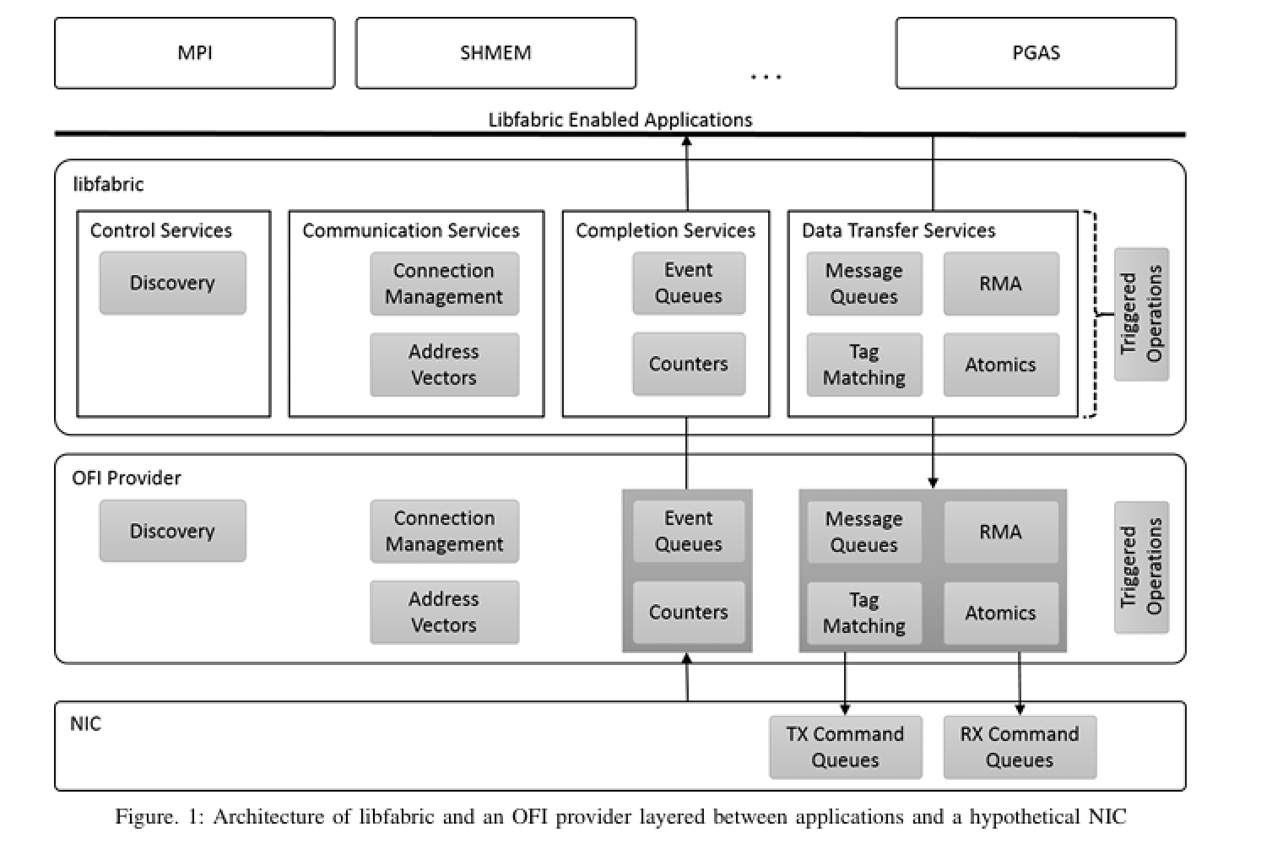
PortAlchemy LibFabric driver
Follow OFI Provider model
Establish Address Vectors
Use default “Event” and ”Message” queues
Either Translate Tag & Atomics to our Ualink MC I/F
Or us NIC I/F and build off a PCI adapter theme
https://openfabrics.org/downloads/ofiwg/Industry_presentations/2015_HotI23/paper.pdf#:~:text=Libfabric%20is%20a%20library%20that%20defines%20and,supported%20on%20commonly%20available%20Linux%20based%20distributions.

Slide 39
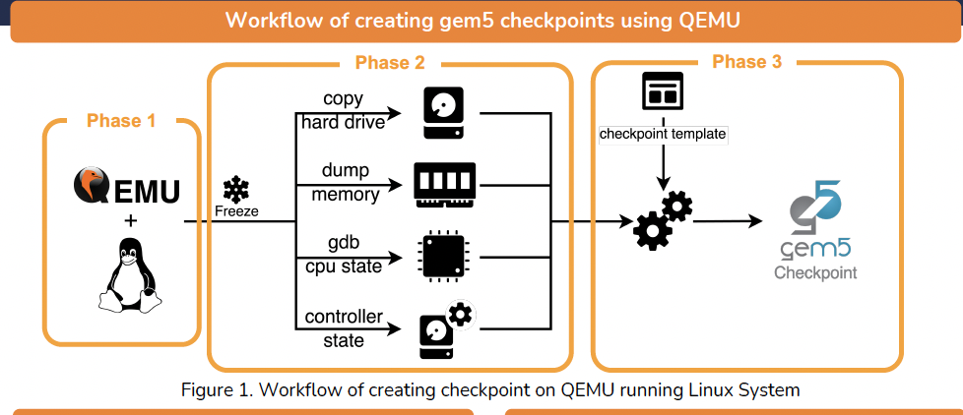
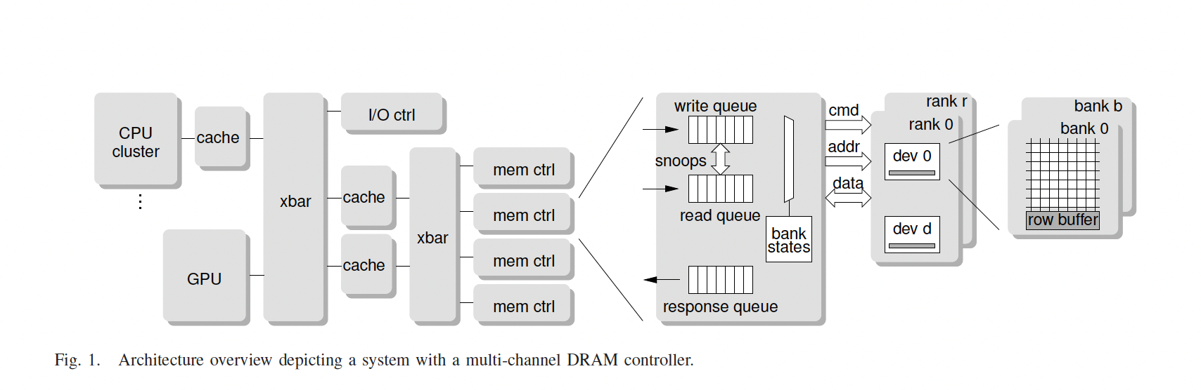
Gem5’n the mess
Vermulator of PortAlchemy’s FPGA
Settle on Arch of Ualink MC (see :mc Dram controller diag)
Couple/adjust the MC &/or Dramctl to be compatible
Adjust for the “alloc”/”free” interface for backing memory with the FPGA mem
(see notes)
Analyze by
Run in Qemu
get checkpoint
transfer to gem
simulate
Notes:
https://akolli.github.io/pubs/gem5-ispass14.pdf

